Slide 1

Moon Phase
By Sameh Hashish

Slide 2

Data
I collected Boston crime data from the following URL.
https://www.moonpage.com/index.html?go=T&auto_dst=T&tzone=et&m=1&d=1&y=1985&hour=0 &min=0&sec=0
crime data of Boston from 2015-06-15 to 2019-01-13.

Slide 3
Hypothesis
Is Moon phase related to crime?

Slide 4
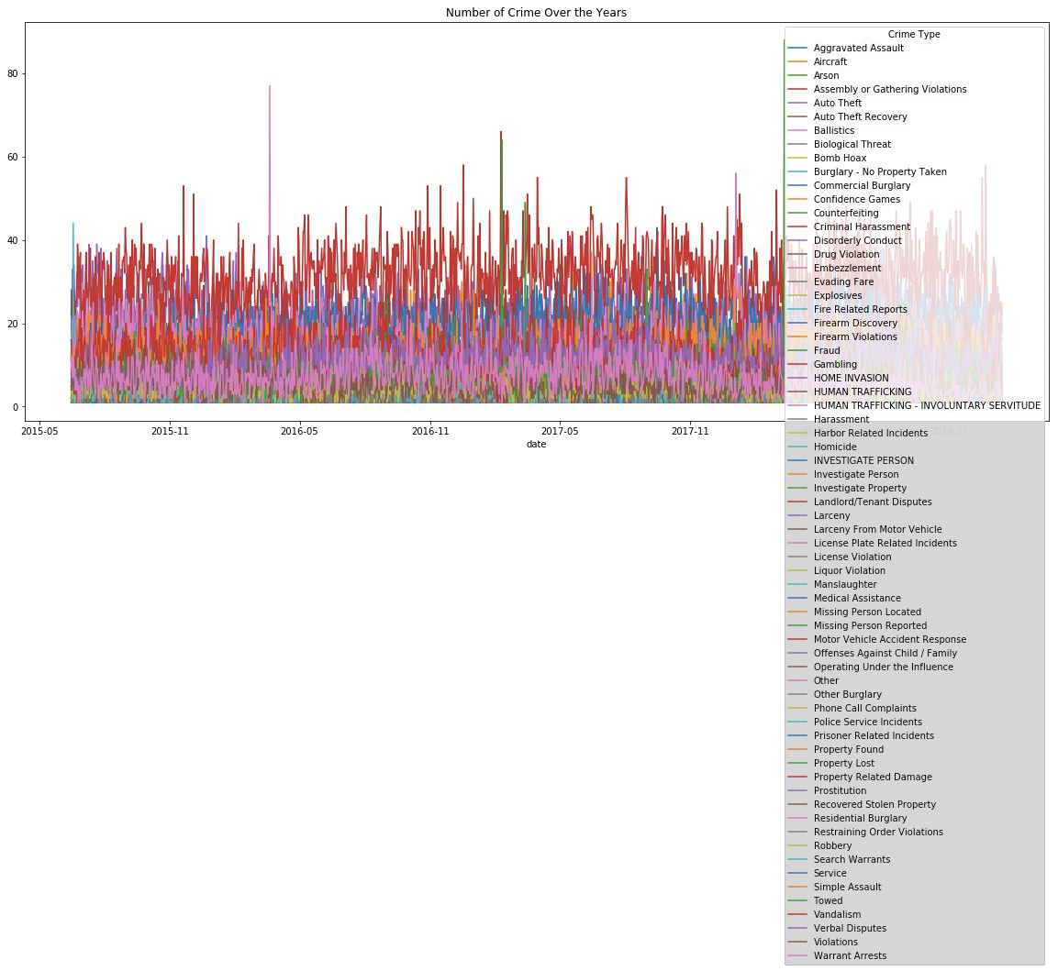
Total Crime By Crime Type over the years
Choosing the graph:
Line chart allows to compare values for continuous variables over a long period of time. The total crime is continuous and daily total crime is numerical value. To get a visual comparison thus a line chart is well suited. From the line chart we can see that the number of each types of crime over the years almost remains same but there’s not a significant changes in daily total crime type. There is no trend in different types of daily total crime.
Data representation on the graph:
first calculated total daily crime for each crime type and then plotted on the line chart.
The line graph shows the total daily crime over the year for each crime type. The x axis is date and y axis total crime type, different colored line different crime type.

Slide 5
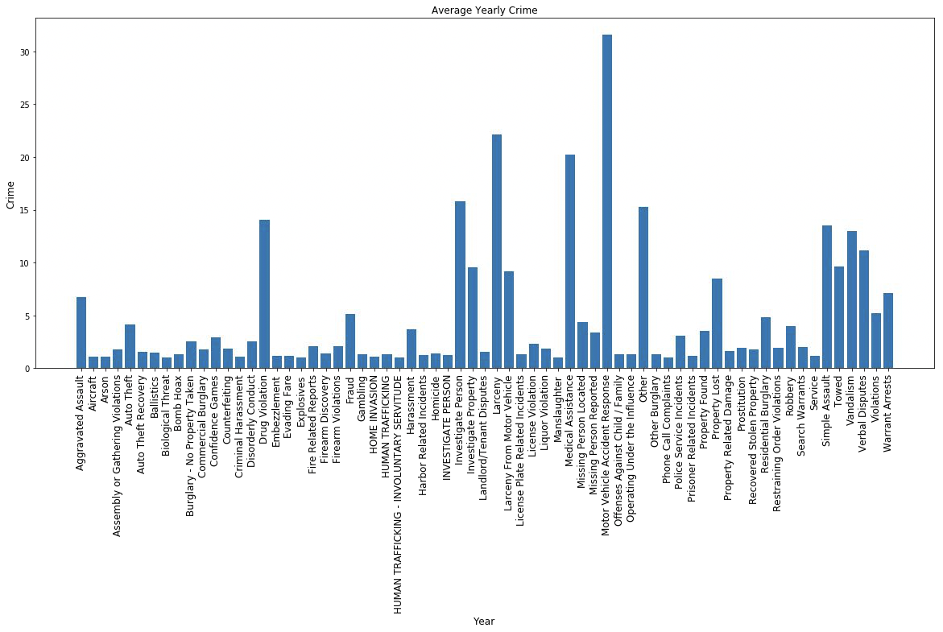
Yearly Average crime for different type of crime
Data representation on the graph:
first calculated average yearly crime for each crime type and then plotted on the bar chart.
The bar graph shows the data collected by showing yearly average crime during for each crime type. First the average yearly crime were calculated and then plotted. The x axis shows the crime type and y axis bar heights indicates average yearly crime .
Choosing the graph:
Bar chart allows to compare values for categorical variables. The crime type is categorical and average yearly crime of different crime type is numerical value. To get a visual comparison thus a bar chart is well suited. From the bar chart we can see that the higher the bar value the higher the average yearly crime for a specific crime type .

Slide 6
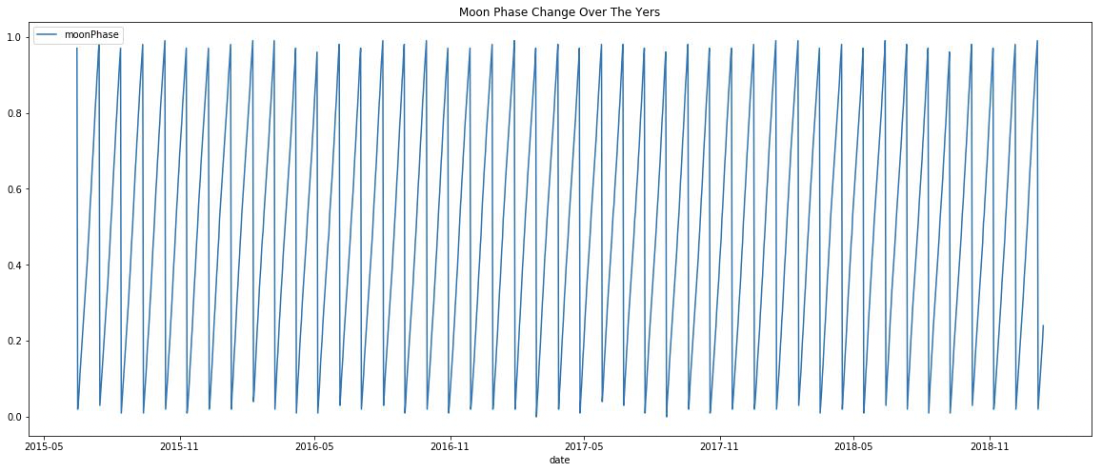
moon phase illumination value during different time of the year over the total period.
Data representation on the graph:
first calculated total daily crime. Then plotted in the line graph.
The graphs shows time on the x axis and moon phase on the y axis. The lines spikes up and downs indicates rise and fall in moon phase illumination value. Here we see a cyclical trend.
Choosing the graph:
I picked this line graph because from it we can see the moon phase i.e. illumination value each day over the total time period. We can see that moon phase at a certain period of time each year increases and decrease at another certain period. The cyclical ups and downs each year moon phase indicates cyclical trend.

Slide 7
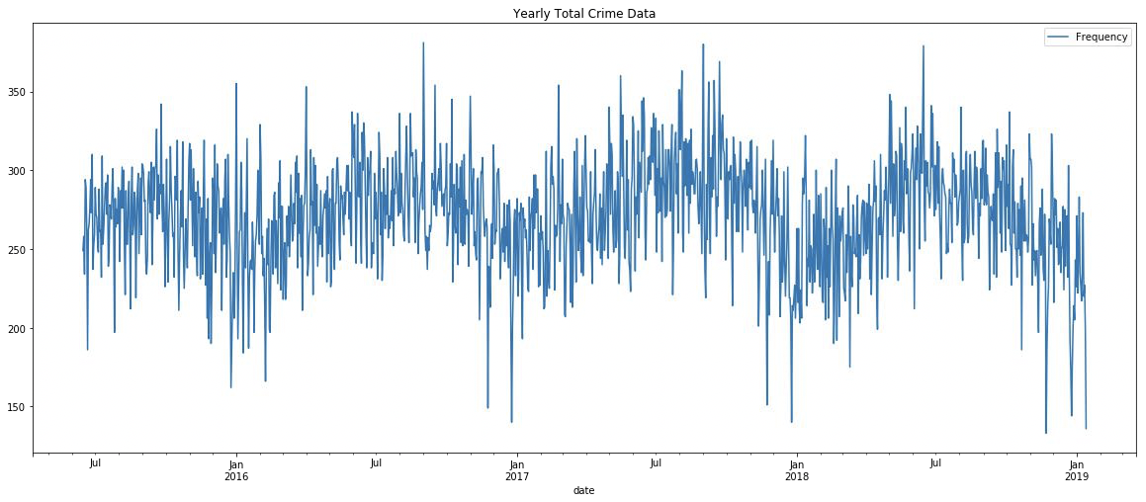
Total crime during different time of the year over total period
Data representation on the graph:
first calculated total crime for different moon phase value. The graphs shows time on the x axis and total crime on the y axis. The lines spikes up and downs indicates rise and fall in total crime. Here we see a cyclical trend.
Choosing the graph:
I picked this line graph because from it we can see the total crime each day over the total time period. We can see that total crime at a certain period of time each year increases and decrease at another certain period. So there is effect of time on total crime. The cyclical ups and downs each year total crime indicates cyclical trend.

Slide 8
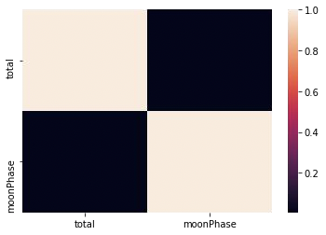
Pearson Correlation Moon Phase Vs total crime
Data representation on the graph:
first calculated Pearson correlation value between total crime and moon phase . Then plotted the heat map using sea born library.
The graphs shows the variables on the x and y axis . The intensity of the color indicates Pearson correlation value. The more brighter the color is the more positive value of the correlation and the more darker means less correlation . From the graph we can see that almost dark color of the corresponding cell means the correlation between the variables is very low and negligible.
Choosing the correlation(Heat Map):
I picked this correlation heat map to get a visual representation of the correlation between moon phase and total crime.
Is There a correlation between overall crime rate and moon phase?
Yes. There is very low positive correlation between overall crime rate and moon phase. The Pearson correlation value between overall crime rate and moon phase is 0.005254 which is negligible.

Slide 9
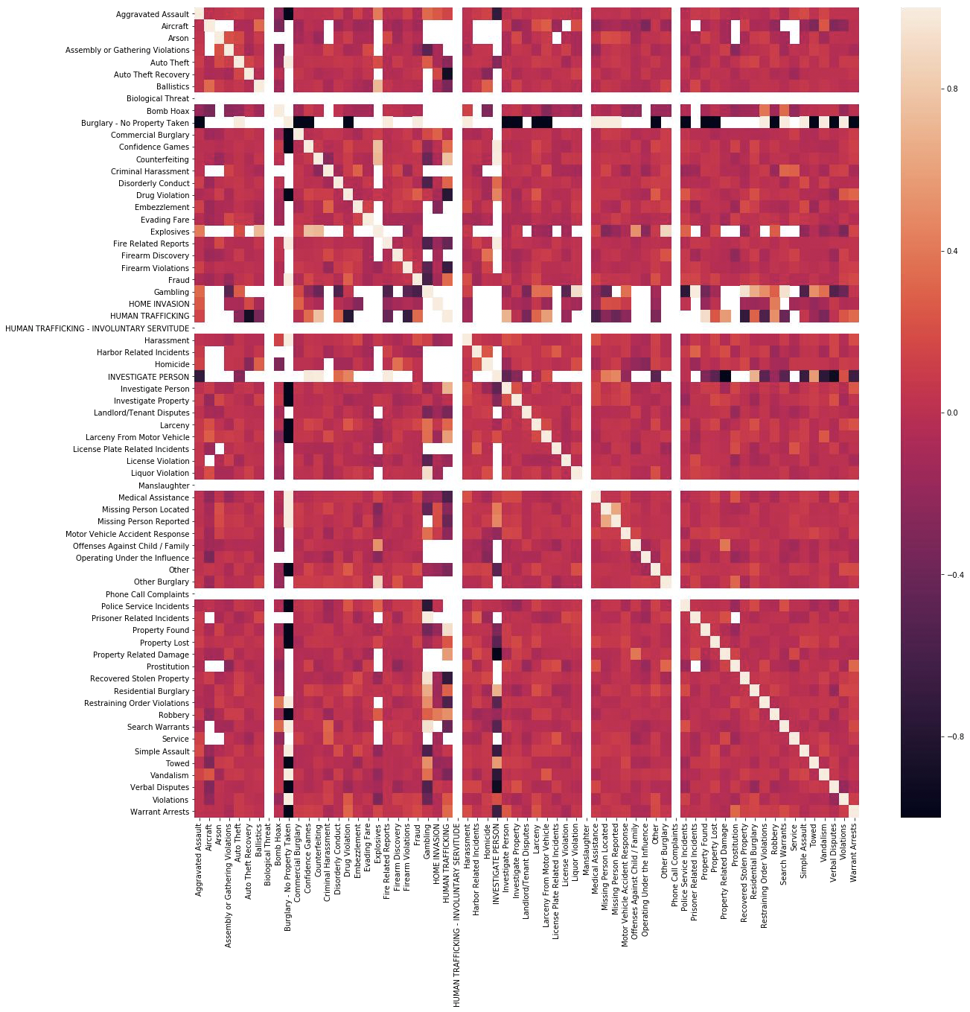
Pearson Correlation Moon Phase vs Type of Crime
Data Representation on the graph:
The graph shows Pearson correlation between each pair of variable of the moon phase and crime combined data. The color indicates correlation value 1 to -1. The more light the color of corresponding cell of two variables the more positive correlation between them, the more darker color of the corresponding cell of two variables the more negative correlation between them.
Choosing the Plot:
I picked this one to get a visual idea of the correlation at once of moon phase and other variables. From here seeing the color and intensity I can get a idea of corresponding variables. The reddish colors indicates positive correlation and darker color indicates negative correlation.
We first calculated Pearson correlation value . Then plotted the heat map using sea born library.

Slide 10
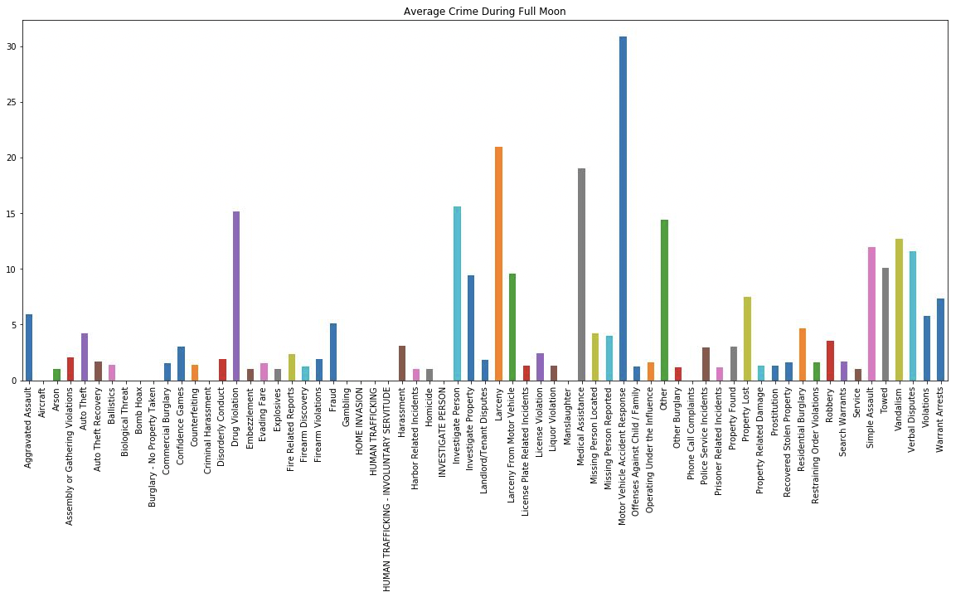
Type vs Full Moon
Data Representation
first calculated average crime during full moon for each crime type. Then plotted in the bar graph.
The bar graph shows the data collected by showing average crime during full moon for each crime type. First the average crime during full moon for each crime type were calculated and then plotted. The x axis shows the crime type and y axis bar heights indicates average crime value.
Choosing the Plot:
Bar chart allows to compare values for categorical variables. The crime type is categorical and average of each crime type is numerical value. To get a visual comparison thus a bar chart is well suited. From the bar chart we can see that the higher the bar the higher the average crime for a specific crime type during full moon.

Slide 11
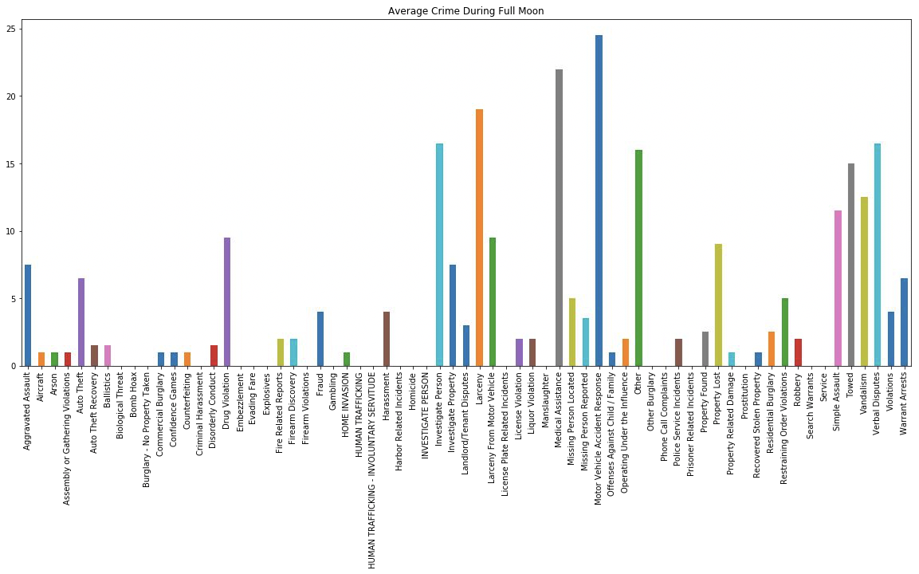
bar chart Type vs New Moon
Data Representation:
first calculated average crime during new moon for each crime type. Then plotted in the bar graph.
The bar graph shows the data collected by showing average crime during new moon for each crime type. First the average crime during new moon for each crime type were calculated and then plotted. The x axis shows the crime type and y axis bar heights indicates average crime value.
Choosing the plot:
Bar chart allows to compare values for categorical variables. The crime type is categorical and average of each crime type is numerical value. To get a visual comparison thus a bar chart is well suited. From the bar chart we can see that the higher the bar the higher the average crime for a specific crime type during new moon.

Slide 12
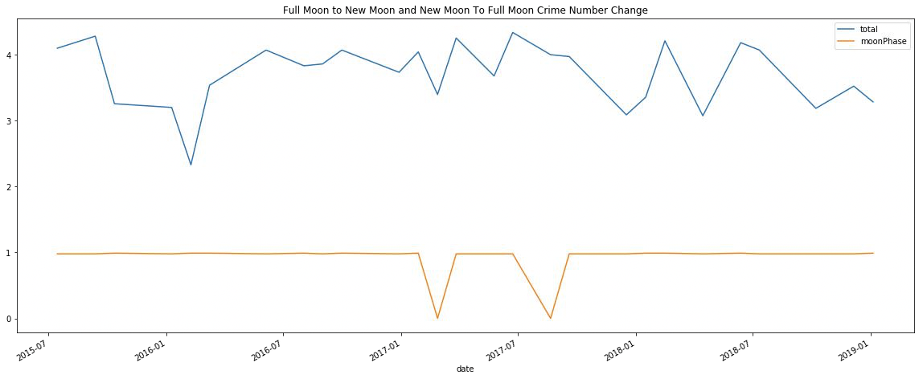
Full Moon Vs New Moon
Data Representation on the the graph :
The line graph shows total number of crime from full moon to new moon and new moon changes for the years 2015-06-15 to 2019-01-13. The orange color is the moon phase value in percentages of illumination . A value of orange color 1 indicates full moon , value closer to 0 indicates new moon.
In order to compare number of crime change from full moon to new moon and new moon to full moon cycle I picked line chart . From the chart I can clearly see and compare crime number ups and down with respect to moon illumination change.

Slide 13
Discussion
Results:
I’ve found what I expected to find. From the data analysis I can conclude that moon has effect on crime rate and crime rate changes cyclically during different time of the years.
Difficulties:
: Difficulties arose during data merge, calculating average values and plotting. I solved them by using Google to find answer , tutorials , reading python documentation and stackoverflow.com answer

Slide 14


Questions

